Slide 1
STEM for Youth
Exercises of “Geometry for Beginners” and “Platonic Solids”.
Gender of Spanish High Schools.
Hilario Mantecón López.
Andrea Pelayo Pérez.
Prof: Pilar Sabariego Arenas

Slide 2
Geometry for Beginners.

Slide 3
Geometry for Beginners.

Slide 4
Geometry for Beginners.

Slide 5
Geometry for Beginners.

Slide 6
Geometry for Beginners.

Slide 7
Geometry for Beginners.

Slide 8
Geometry for Beginners.

Slide 9
Geometry for Beginners.

Slide 10
Geometry for Beginners.

Slide 11
Geometry for Beginners.

Slide 12
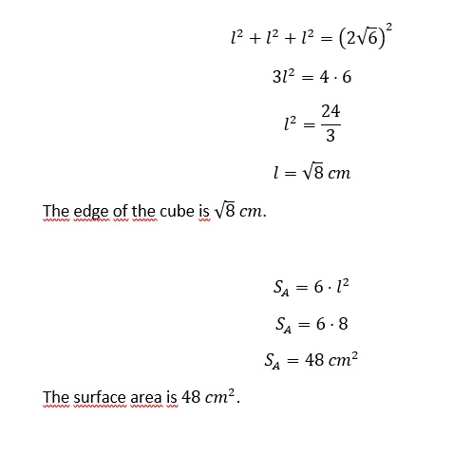
Geometry for Beginners.

Slide 13
Geometry for Beginners.

Slide 14
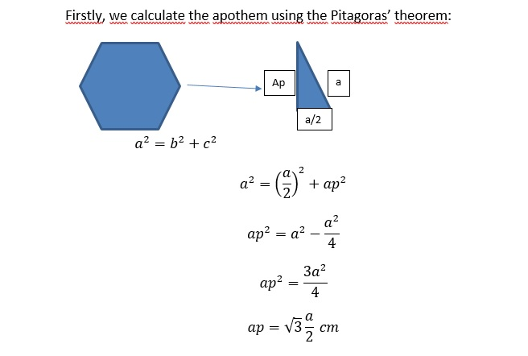
Geometry for Beginners.

Slide 15
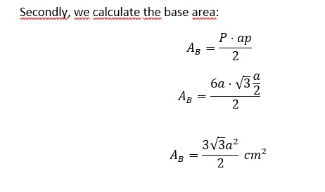
Geometry for Beginners.

Slide 16
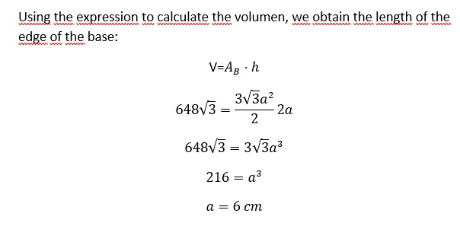
Geometry for Beginners.

Slide 17
Geometry for Beginners.

Slide 18
Geometry for Beginners.

Slide 19
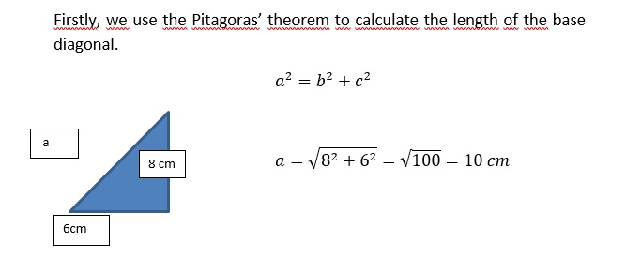
Geometry for Beginners.

Slide 20
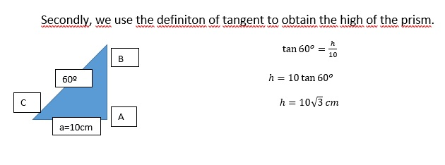
Geometry for Beginners.

Slide 21
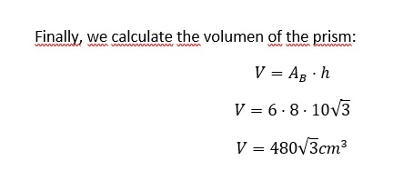
Geometry for Beginners.

Slide 22
Geometry for Beginners.

Slide 23
Geometry for Beginners.

Slide 24
Geometry for Beginners.

Slide 25
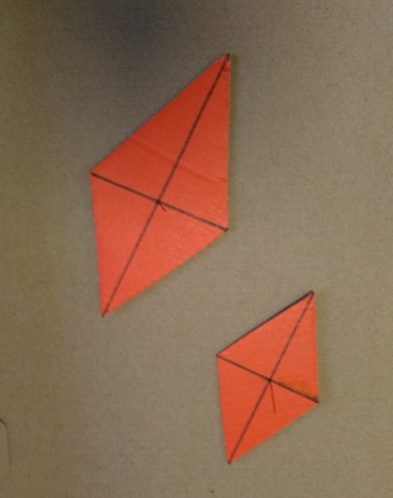
Geometry for Beginners.
It has just one point of symmetry. The one where the diagonals cut. The reflection through it maps the rhombus into itself.
To see it, we use a pin in the point where the diagonals cut and made the rhombus rotate over it.

Slide 26
Geometry for Beginners.

Slide 27
Platonic Solids.

Slide 28
Platonic Solids.

Slide 29
Platonic Solids.

Slide 30
Platonic Solids.

Slide 31
STEM for Youth.
Thank you very much!

