Slide 1
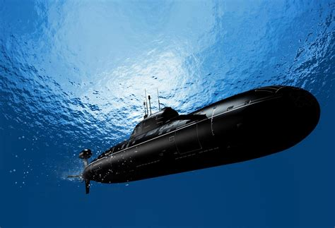
Underwater Engineering
An experiment: From the basics to the top

Slide 2
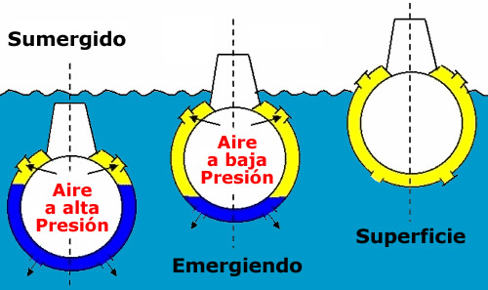
How do submarines submerge and float in water?
How they dive...
To sink, submarines increase their density by filling the tanks with seawater. They open the tank gate to allow water to get inside.
How they float…
Submarines float by emptying the tanks which used to store water

Slide 3
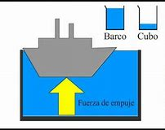
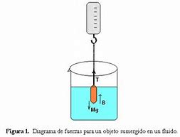
Archimedes´ principle
The principle of Archimedes states that any body completely or partially submerged in a fluid (gas or liquid) at rest is acted upon by an upward, or buoyant, force the magnitude of which is equal to the weight of the fluid displaced by the body.

Slide 4
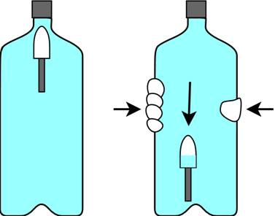
Our first exoeriment
We tried to replicate the way a submarine submerges and floats. To do so, we used a bottle and applied the Archimedes´ principle.

Slide 5
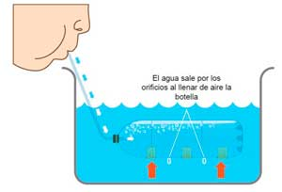
Taking it a step further
We applied the same principle using a bucket with water and a plastic water with some weight in it.

Slide 6
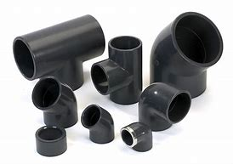
Our next steps
We want to build a replica of a submarine that can submerge by its own weight and be controlled using a remote control.
Recycled materials
Micro bit

